Slide 1
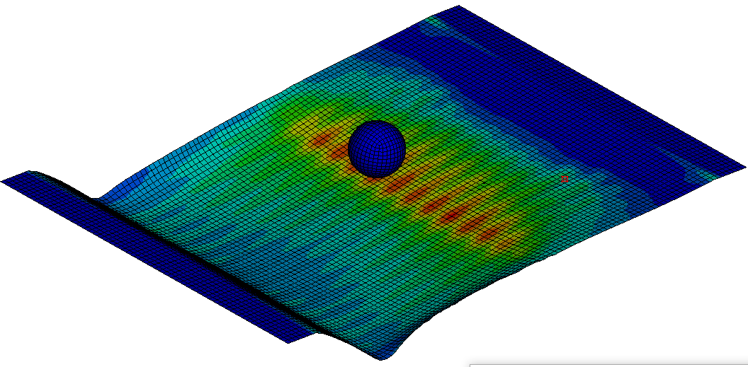
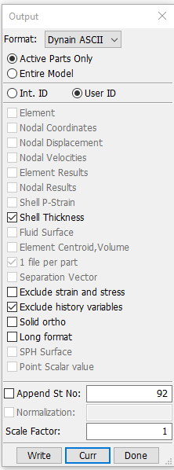
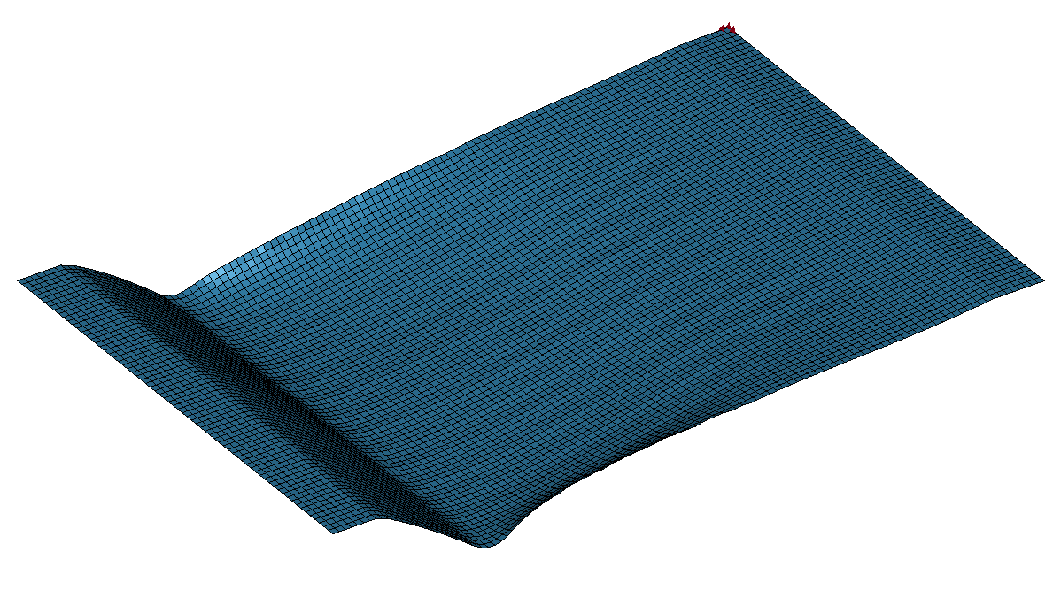
Initial Setup
FEM, forming simulation, explicit
One fixed note
FEM, springback simulation, implicit
LS-Dyna output from explicit forming simulation is called „Dynain ASCII“
It automatically contains the correct format for the LS-Dyna implicit springback simulation

Slide 2
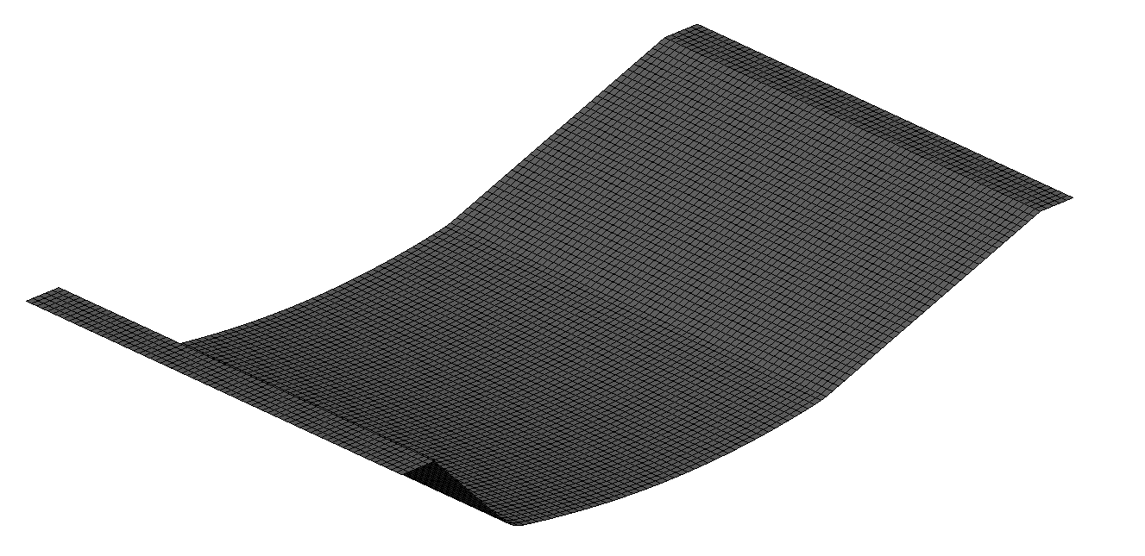
New Setup
Assign FEM results to .stl
FEM, forming simulation, explicit
One fixed note
FEM, springback simulation, implicit
Run springback simulation with the .stl part:
It has the .stl „perfect shape“ but the results of the actual FEM simulation. It can, but not necessarily must have, interpolated results

Slide 3
former code accepted these three inputs:
- Node Coordiantes
- Element connectivity
- Nodal results (e.g. vMises Stress)
but the springback simulation needs the following three inputs in the correct format provided by the export:
- Element shell thickness (element connectivity + shell thickness in two lines)
- Node Coordinates
- Element results (initial stress shell, initial strain shell)
→ Modification of the code

Slide 4

Explanation of the input file for springback simulation:
Header
The file was exported from the explicit model in state 92 and time 4.53049, which represents the final state and time is this model

Slide 5
Explanation of the input file for springback simulation:
1. Input keyword „element shell thickness“:
Part ID:
Element 40741 belongs to part 2
keyword
Connectivity:
Element 40741 consists of the nodes 43971, 43972, 43902, 43901
Element ID:
It is the element 40741
Shell thickness values:
Current shell thickness of/at nodes 43971, 43972, 43902, 43901 (probably)
Here right now they are all 1.00 because the element 40741 is contrained and does not deform

Slide 6

Explanation of the input file for springback simulation:
2. Input keyword „node coordinates“:
keyword
Nodal coordinates
Node IDs:

Slide 7
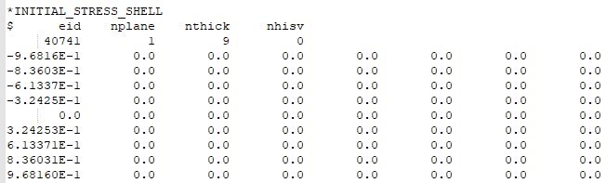
Explanation of the input file for springback simulation:
Number of through thickness integration points.
3. Input keyword „initial stress“:
Number of in plane integration points being output.
keyword
Number of additional history variables.
Element ID:
Integration point IDs?
Integration point position in shell thicknes direction?
9 integration points
Stress results

Slide 8
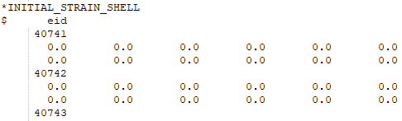
Explanation of the input file for springback simulation:
4. Input keyword „initial strain“:
keyword
Strain results, but I dont know why they are 12
Element ID:
Next element ID and so on…

Slide 9

Explanation of the input file for springback simulation:
End of file

